Slide 1
Topics in Chapter 1
1.1 Introduction
1.2 Classes of computers
1.3 Defining computer architecture and What’s the task of computer design?
1.4 Trends in Technology
1.5 Trends in power in Integrated circuits
1.6 Trends in Cost
1.7 Dependability
1.8 Measuring, Reporting and summerizing Perf.
1.9 Quantitative Principles of computer Design
1.10 Putting it altogether

Slide 2
What’s CA?
What’s a CA designer’s task ?

Slide 3
What’s Computer Architecture
Patterson’s talk : “50 years of Computer Architecture”
https://www.bilibili.com/video/av46710093/
The future of computing- a conversation with John Hennessy
https://www.bilibili.com/video/av23283946/
Technology
A key factor in the long run of CPU performance improvement.

Slide 4
History of the Computer
Original:
Big Fishes Eating Little Fishes

Slide 5
1988 Computer Food Chain
Mainframe
1960s
Work-
Station
1980s-2000s
Mini-
Supercomputer
1970s
PC
2010s
Mini-
Computer
1970s
Supercomputer
1970s
Massively Parallel Processors
1980s

Slide 6
1998 Computer Food Chain
Mini-
Supercomputer
1970s
Mini-
Computer
1970s
Massively Parallel Processors
1980s
Embedded system
2010s
Mainframe
1960s
Work-
Station
1980-2000s
PC
2010
Server
2010s
Supercomputer
1970s

Slide 7
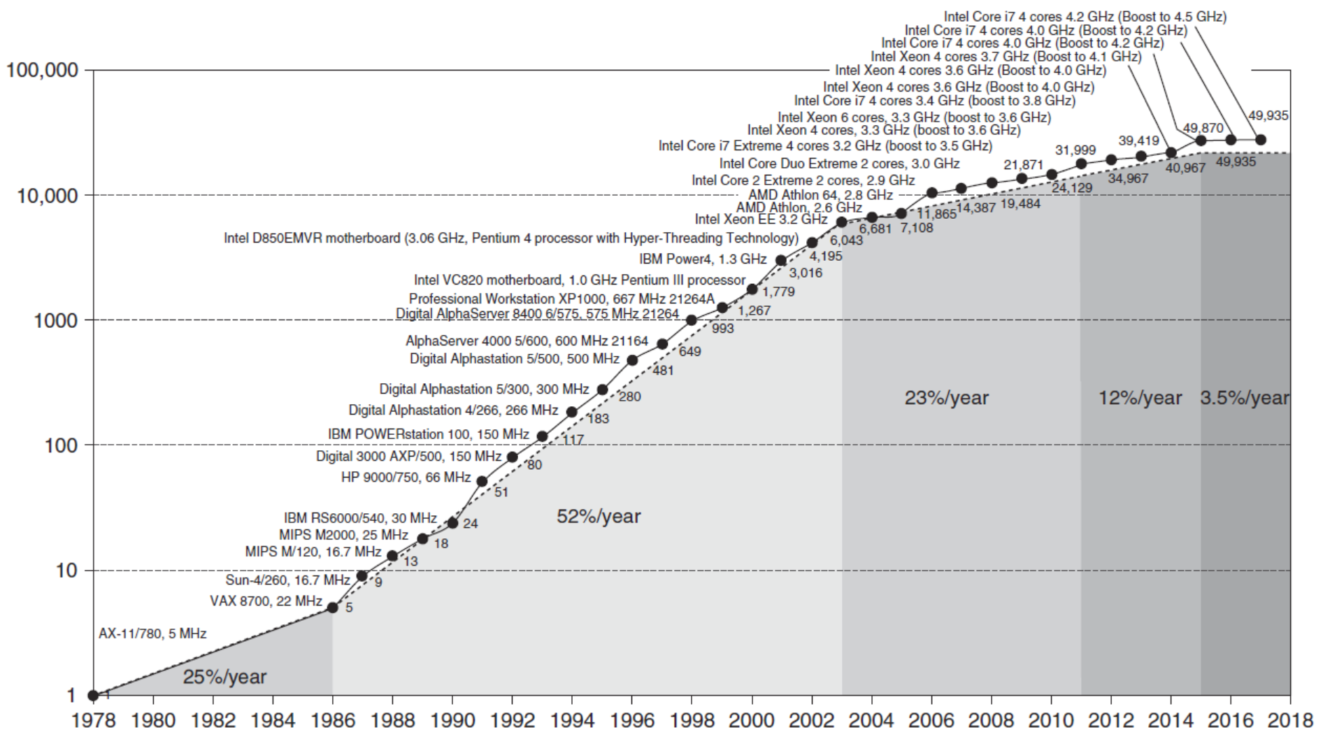
Incredible CPU performance improvement
VAX : 25%/year 1978 to 1986； RISC+x86: 52%/year 1986 to 2002； RISC+x86: 22%/year after 2002

Slide 8
What the figure tell us ?
Performance improvements:
25%: Technological improvements more steady than progress in computer architecture.
Feature size, clock speed
52%: After RISC emergence, computer design emphasized both architectural innovation and efficient use of technology improvements.
Computer Architecture plays an important role in performance improvement
Pipeline, dynamic scheduling, ooo, branch prediction,
speculation, superscalar, VLIW, prediction instructions, ……

Slide 9
Why Such Change in 60 years?
Technology Advances
CMOS VLSI dominates older technologies (TTL, ECL) in cost AND performance
Computer architecture advances improves low-end
RISC, superscalar, OOO, Speculation, VLIW, RAID, …
Together have enabled:
Lightweight computers
Productivity-based managed/interpreted programming languages
Price: Lower costs due to …
Simpler development: smaller systems, fewer components
Higher volumes: same dev. cost 10,000 vs. 10,000,000 units
Lower margins by class of computer, due to fewer services
Function and Usage
scientific computing →non-digital processing → embedded system
Rise of networking/local interconnection technology

Slide 10
4 Decades of microprocessor
Computer organization
Computer Architecture
Advanced CA
MultiCore
The Decade of the 1970’s “Microprocessors”
- Programmable Controller (microprogramming)
- Single-Chip Microprocessors
- Personal Computers (PC)
The Decade of the 1980’s “Quantitative Architecture”
- Instruction Pipelining
- Fast Cache Memories
- Compiler Considerations
- Workstations
The Decade of the 1990’s “Instruction-Level Parallelism”
- Superscalar Processors
- Speculative Microarchitectures
- Aggressive Code Scheduling
- Low-Cost Desktop/Supercomputing
The Decade of the 2000’s “Thread-level/Data-level parallelism”

Slide 11
What’s Computer Architecture
Concept Evolution
The attributes of a [computing] system as seen by the programmer, i.e.,
the conceptual structure and functional behavior, as distinct from the organization of the data flows and controls the logic design, and the physical implementation.
Amdahl, Blaaw, and Brooks, 1964

Slide 12
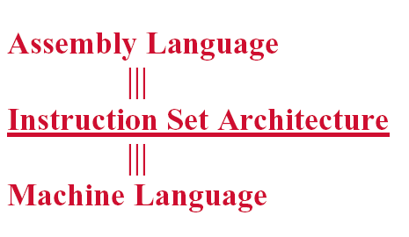
Programmer’s perceptual
Notes:
From the view of language, a computer can be viewed as multiple level virtual machine.
How can we improve the performance ? We explore the parallelisms.

Slide 13
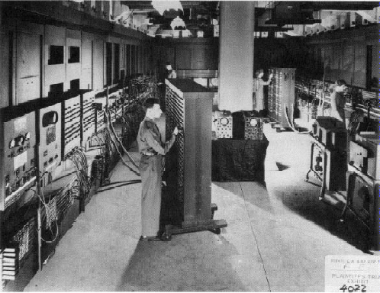
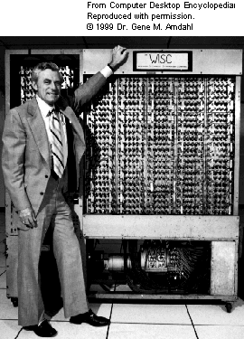
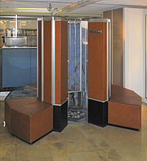
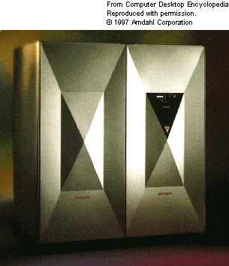
Very different appearance

Slide 14
Very Different ISA
PDP-11
IBM 360
VAX
CRAY
…
LC3
80x86
PowerPC
MIPS
ARM
RISC V

Slide 15
New Concepts ?
Tradeoff
Computer Architecture is the science and art of selecting and interconnecting hardware components to create computers that meet functional, performance, cost and power goals.
It is a blueprint and functional description of requirements and design implementations for the various parts of a computer, focusing largely on the way by which the central processing unit (CPU) performs internally and accesses addresses in memory.

Slide 16
Computer architecture
Computer architecture comprises at least three main subcategories:^{[1]}
Instruction set architecture,
Microarchitecture, also known as Computer organization is a lower level, more concrete and detailed, description of the system that involves how the constituent parts of the system are interconnected and how they interoperate in order to implement the ISA.[
System Design which includes all of the other hardware components within a computing system such as:
Logic Implementation
Circuit Implementation
Physical Implementation

Slide 17
Seven dimensions of ISA
Class of ISA
Memory addressing
Addressing modes
Types and sizes of operands
Operations
Control flow instructions
Encoding an ISA

Slide 18
Computer Applications
Architects need to understand applications’ behavior
We say we design general purpose processors, but they really focus on specific sets of applications
Architecture can be tuned to applications
Types of applications today
Scientific
Weather prediction, crash analysis, earthquake analysis, medical imaging, imaging of the earth (searching for oil)
Business
database, data mining, video
General purpose
Microsoft Word, Excel
Real-time
automated control systems,
Others: Games, Mobile，Internet of Things，5G

Slide 19
The Task of Computer Design-2
Determine the important attributes of a new machine to maximize performance while staying with constrains, such as cost, power, availability, etc.
instruction set architecture design
functional organization
High level aspects of computer design, i.e. memory system, bus architecture and internal CPU design.
logic design ( hardware )
implementation (hardware )

Slide 20
Incredible CPU performance improvement
VAX : 25%/year 1978 to 1986； RISC+x86: 52%/year 1986 to 2002； RISC+x86: 22%/year after 2002

Slide 21
Challenges of “three walls”
ILP Wall
diminishing returns on finding more ILP HW (Explicit thread and data parallelism must be exploited)
Memory Wall
growing disparity of speed between CPU and memory outside the CPU chip. Memory latency would become an overwhelming bottleneck in computer performance.
Power Wall
the trend of consuming double the power with each doubling of operating frequency

Slide 22
Trends of Computer Architecture
Why?
ILP → TLP(thread level parallel)
→ DLP(data level parallel),
Google file system, MapReduce, column-oriented DB
2D memory → 3D stack memory
Performance → Power-aware design

Slide 23
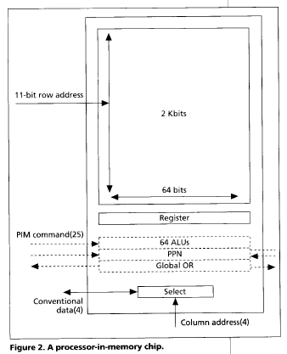
Computational RAM / PIM
Processor in memory (PIM)
Processing in memory (PIM, sometimes called processor in memory) is the integration of a processor with RAM (random access memory) on a single chip. The result is sometimes
known as a PIM chip.
1995. 4 IEEE computer
Processing in memory: the
Terasys massively Parallel PIM Array.

Slide 24
Memory as an Accelerator
CPU
core
CPU
core
Mini-CPU core
GPU
core
GPU
core
Memory
Video
core
CPU
core
CPU
core
GPU
core
GPU
core
Imaging core
Lower Level Cache
Specialized
Compute capability in memory
Memory controller
Bitwise Operation： In-DRAM copy，zero，and，or，not

Slide 25
Current Trends in Architecture
Cannot continue to leverage Instruction-Level parallelism (ILP)
Single processor performance improvement ended in 2003
New models for performance:
Data-level parallelism (DLP)
Thread-level parallelism (TLP)
Request-level parallelism (RLP)
These require explicit restructuring of the application

Slide 26
Recent research fields
Power-aware computer architecture
Reconfigurable computer architecture
Multicore, Manycore,
PIM： Processor in Memory
AI processor -----GPU & FPGA
DSA： Domain Specific Architecture
Hardware and Software Codesign

Slide 27
Where to explore the parallelism ?
Implicity, compiler and hardware
→ Explicity, programmer
So, YOU, programmers have to know parallelism in hardware, and to explore parallelism when design Algorithm and programming !
Parallelism
Hardware → Hardware and compiler → compiler and programmer
ILP, Loop-level Parallism → TLP, DLP

Slide 28
Something more about CA

Slide 29
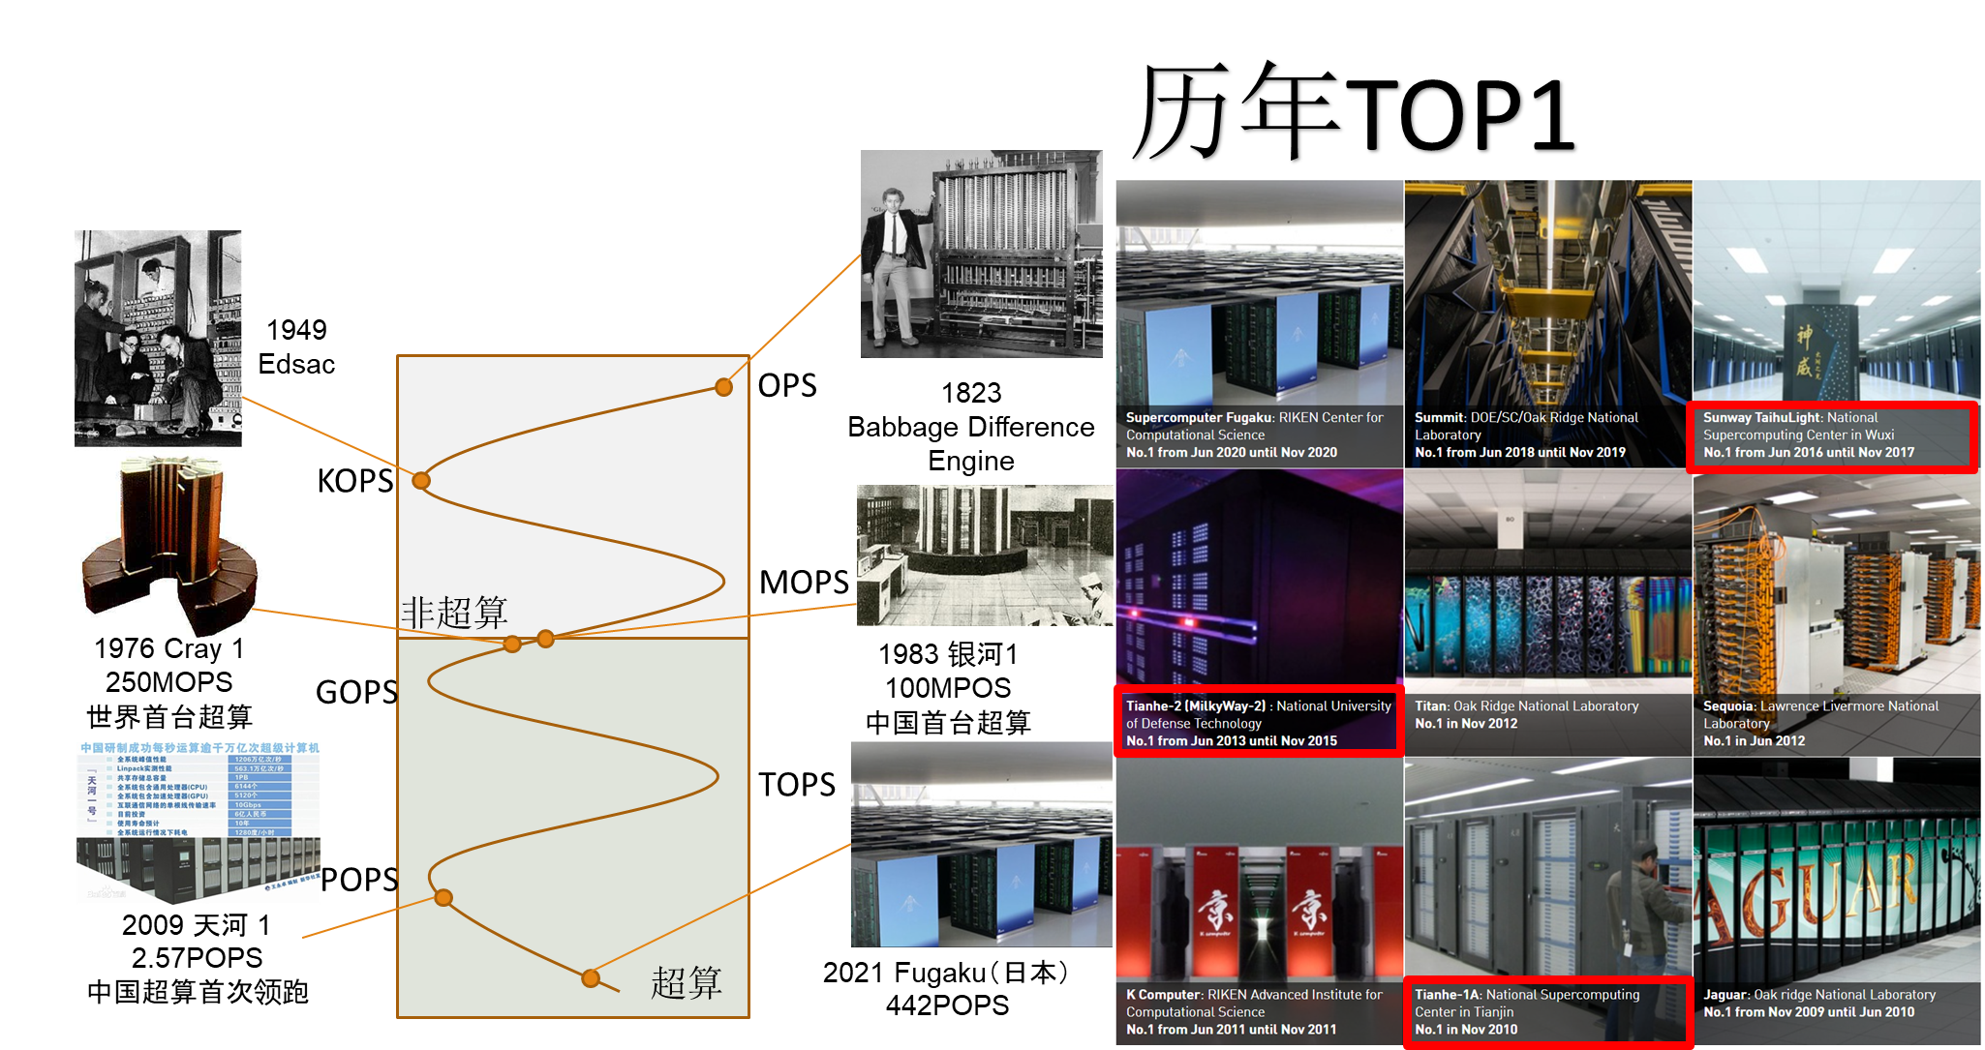
Fastest computer

Slide 30
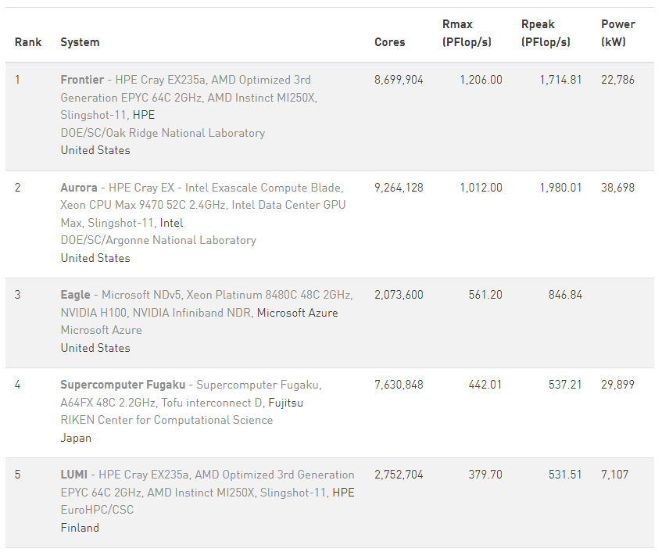
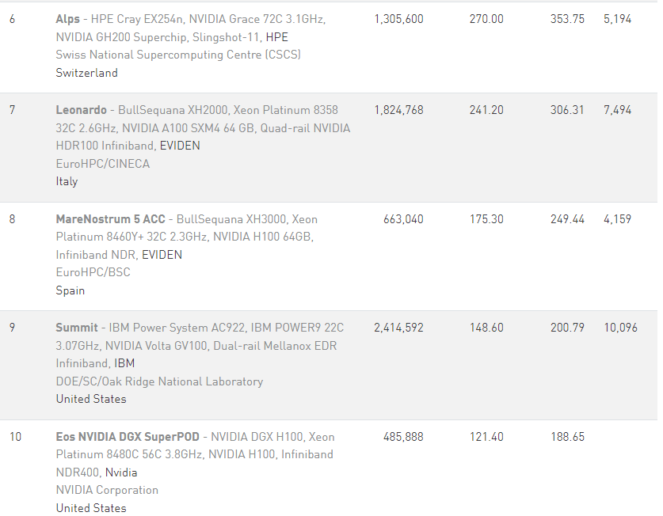
Fastest computer (2024.6 Top10)
2024年没有来自国内的超算平台入围

Slide 31
Fastest computer in China
2011 Tianhe-1A - MPP
2008 Dawning 5000A
30720 node * AMD Opteron 1.9Ghz QC
Memory: 122.88TB, Infiniband, 180.6 TeraFLOPS
OS: Windows HPC 2008
Rank 10 in top 500 in Nov. 2008
2004 Dawning 4000A
11 TeraFLOPS
rank 10 in top 500 in June, 2004
2003 ShenTeng6800
5.324 TeraFLOPS
2002 ShenTeng1800
2.04 TeraFLOPS
2000 YinHe IV
1024个CPU
1 TeraFLOPS

Slide 32
What are the fastest computers?
http://top500.org/ June. 2011
1 K computer, SPARC64 VIIIfx 2.0GHz, Tofu interconnect
2 Tianhe-1A - MPP, X5670 2.93Ghz 6C, NVIDIA GPU, FT-1000 8C
3 Jaguar - Cray XT5-HE Opteron 6-core 2.6 GHz
4 Nebulae - Dawning TC3600 Blade, Intel X5650, NVidia Tesla C2050 GPU
5 TSUBAME 2.0 - HP ProLiant SL390s G7 Xeon 6C X5670, Nvidia GPU, Linux/Windows
6 Cielo - Cray XE6 8-core 2.4 GHz
7 Pleiades - SGI Altix ICE 8200EX/8400EX, Xeon HT QC 3.0/Xeon 5570/5670 2.93 Ghz, Infiniband
8 Hopper - Cray XE6 12-core 2.1 GHz
9 Tera-100 - Bull bullx super-node S6010/S6030
10 Roadrunner - BladeCenter QS22/LS21 Cluster, PowerXCell 8i 3.2 Ghz / Opteron DC 1.8 GHz, Voltaire Infiniband

Slide 33
Fastest Supercomputer in the world from http://top500.org/ June. 2013
Rank | Site | System | Cores | Rmax (TFlop/s) | Tpeak (TFlop/s) | Power (kW)
1 | National University of Defense Technology China | Tianhe-2 (MilkyWay-2) - TH-IVB-FEP Cluster, Intel Xeon E5-2692 12C 2.200GHz, TH Express-2, Intel Xeon Phi 31S1P NUDT | 3,120,000 | 33,862.7 | 54,902.4 | 17,808
2 | DOE/SC/Oak Ridge National Laboratory USA | Titan - Cray XK7 , Opteron 6274 16C 2.200GHz, Cray Gemini interconnect, NVIDIA K20x Cray Inc. | 560,640 | 17,590.0 | 27,112.5 | 8,209
3 | DOE/NNSA/LLNL USA | Sequoia - BlueGene/Q, Power BQC 16C 1.60 GHz, Custom IBM | 1,572,864 | 17,173.2 | 20,132.7 | 7,890
4 | RIKEN Advanced Institute for Computational Science (AICS) Japan | K computer, SPARC64 VIIIfx 2.0GHz, Tofu interconnect Fujitsu | 705,024 | 10,510.0 | 11,280.4 | 12,660
5 | DOE/SC/Argonne National Laboratory USA | Mira - BlueGene/Q, Power BQC 16C 1.60GHz, Custom IBM | 786,432 | 8,586.6 | 10,066.3 | 3,945
6 | Texas Advanced Computing Center/Univ. of Texas USA | Stampede - PowerEdge C8220, Xeon E5-2680 8C 2.700GHz, Infiniband FDR, Intel Xeon Phi SE10P Dell | 462,462 | 5,168.1 | 8,520.1 | 4,510
7 | Forschungszentrum Juelich (FZJ) Germany | JUQUEEN - BlueGene/Q, Power BQC 16C 1.600GHz, Custom Interconnect IBM | 458,752 | 5,008.9 | 5,872.0 | 2,301
8 | DOE/NNSA/LLNL USA | Vulcan - BlueGene/Q, Power BQC 16C 1.600GHz, Custom Interconnect IBM | 393,216 | 4,293.3 | 5,033.2 | 1,972
9 | Leibniz Rechenzentrum Germany | SuperMUC - iDataPlex DX360M4, Xeon E5-2680 8C 2.70GHz, Infiniband FDR IBM | 147,456 | 2,897.0 | 3,185.1 | 3,423
10 | National Supercomputing Center in Tianjin China | Tianhe-1A - NUDT YH MPP, Xeon X5670 6C 2.93 GHz, NVIDIA 2050 NUDT | 186,368 | 2,566.0 | 4,701.0 | 4,040

Slide 34
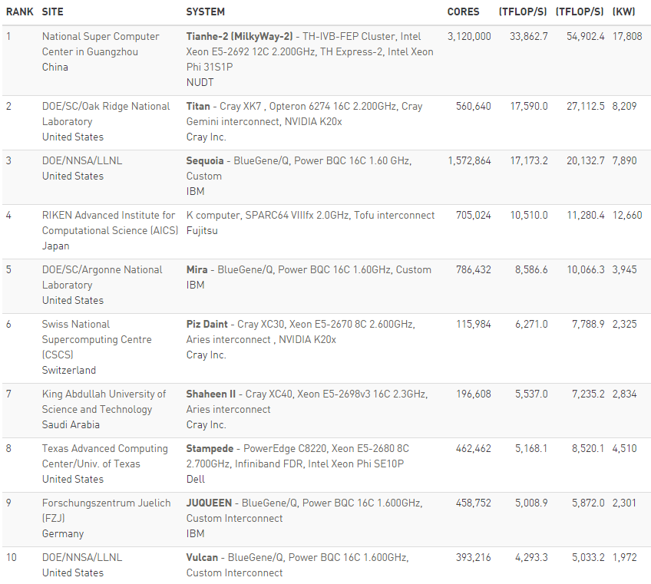
Fastest Supercomputer in the world from http://top500.org/ June，2015

Slide 35
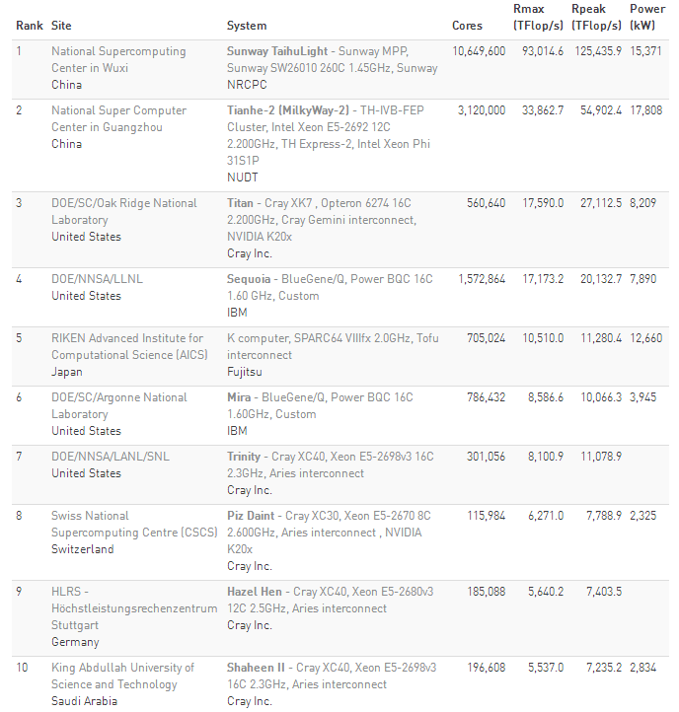
Fastest Supercomputer in the world from http://top500.org/ June. 2016

Slide 36
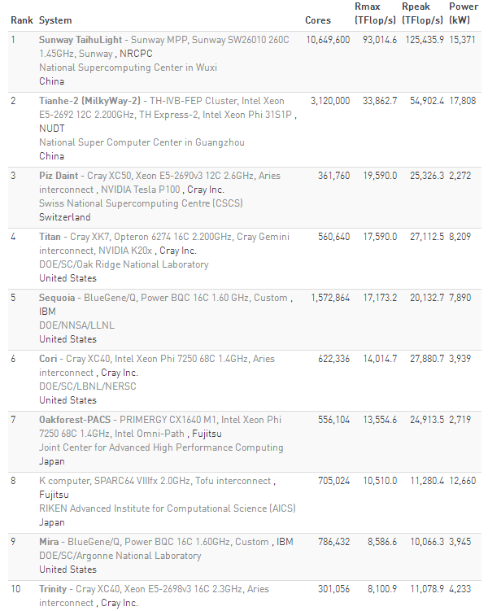
Fastest Supercomputer in the world from http://top500.org/ June. 2017

Slide 37
Overview of TH-2
Items | Configuration
Processors | 32000 Intel Xeon CPUs + 48000 Xeon Phis + 4096 FT CPUs Peak performance is 54.9 Pflops, sustained performance 33.9PFlops
Interconnect | Proprietary high speed interconnection network TH Express-2
Memory | 1.4PB in total
Storage | Global shared parallel storage system, 12.4 PB
Cabinets | 125+13+24+8 = 170 Compute/Communication/Storage/Service Cabinets
Power | 17.8MW
Cooling | Closed Air Cooling System

Slide 38
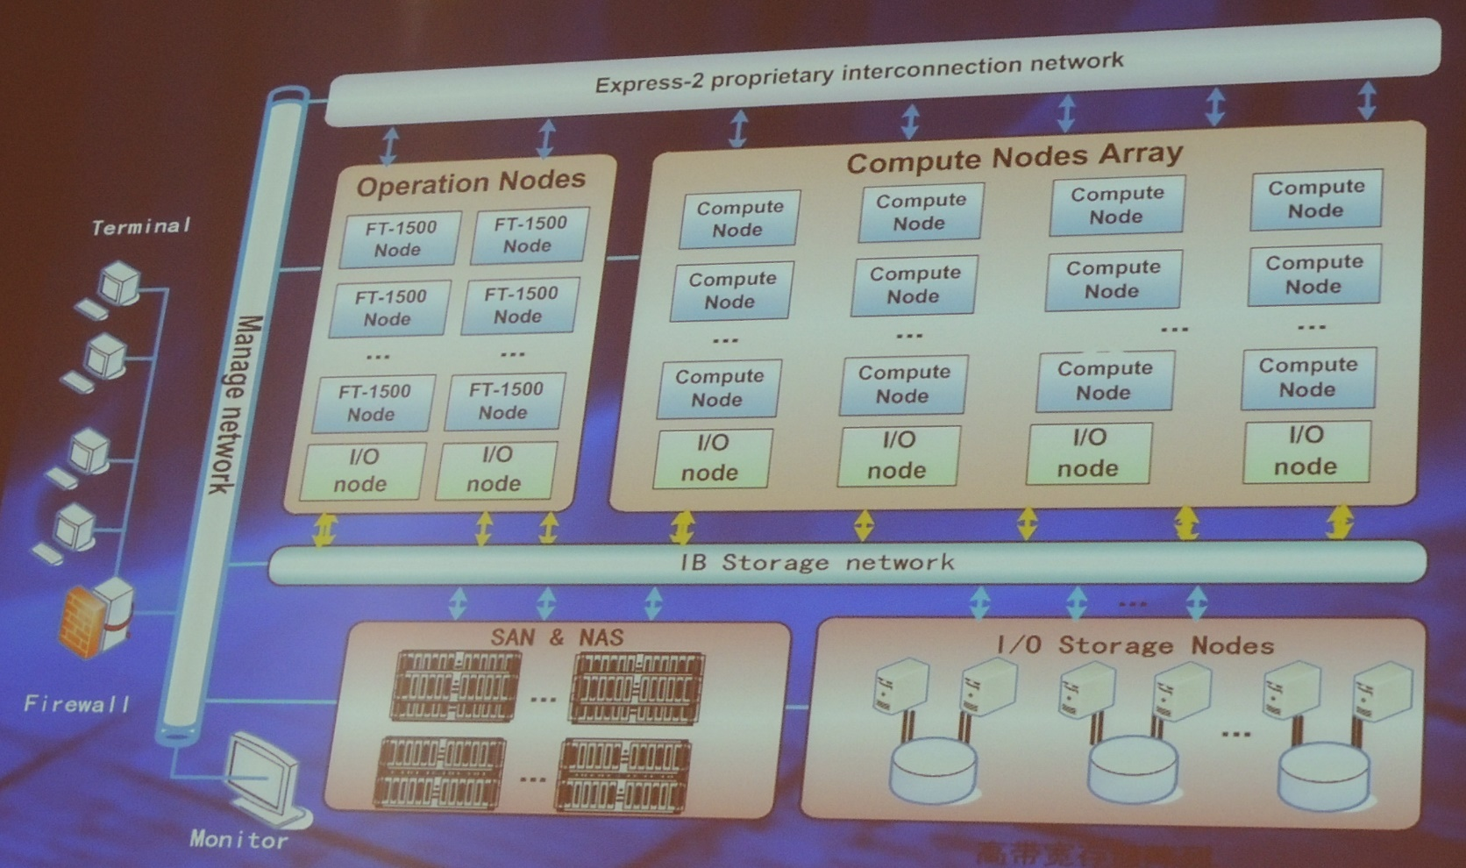
Hardware subsystem of TH-2

Slide 39
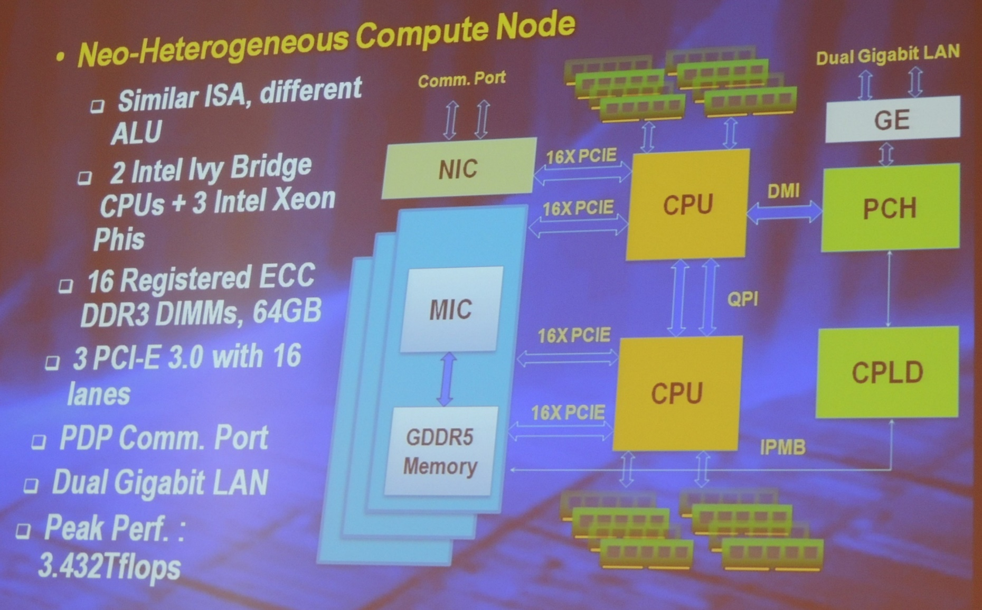
Comuter Node of TH-2

Slide 40
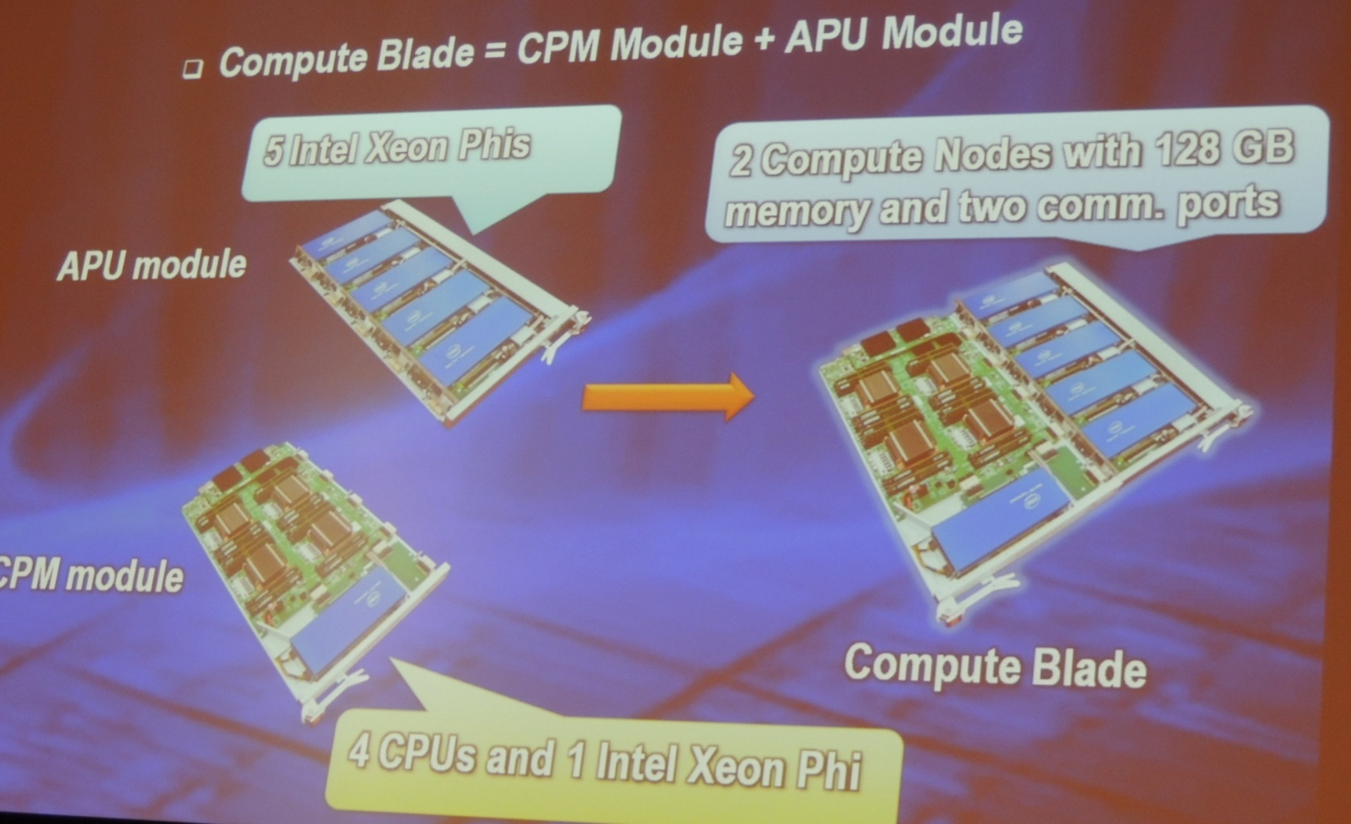
Comuter Node of TH-2

Slide 41
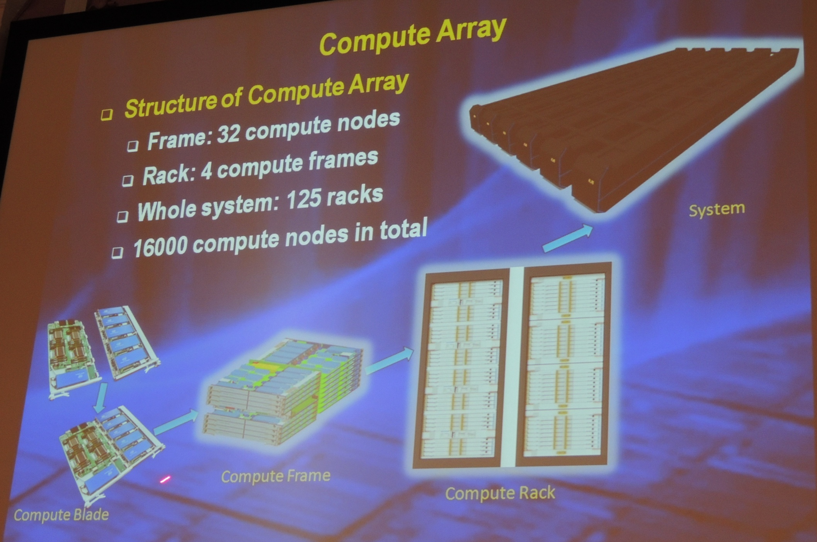
Computer Array of TH-2

Slide 42
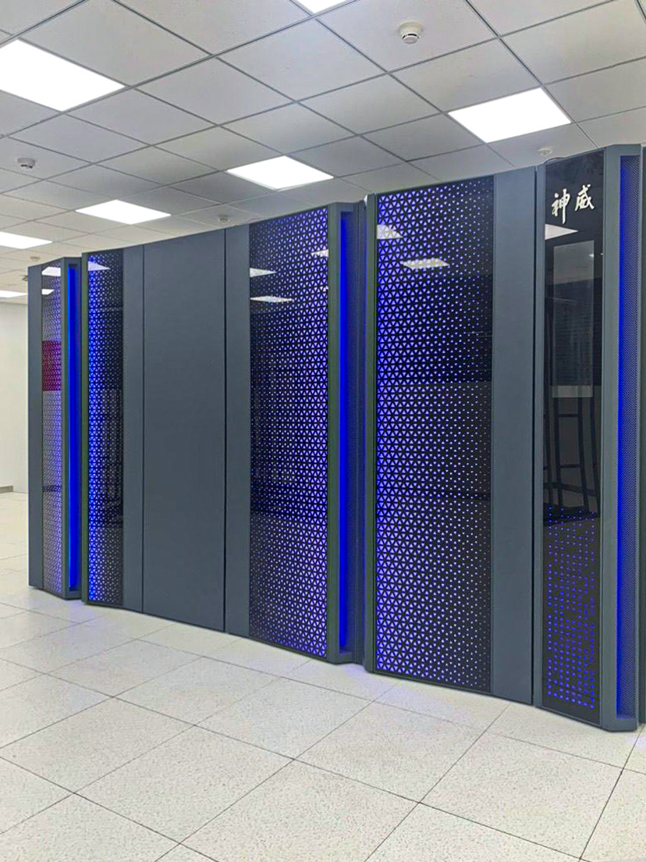
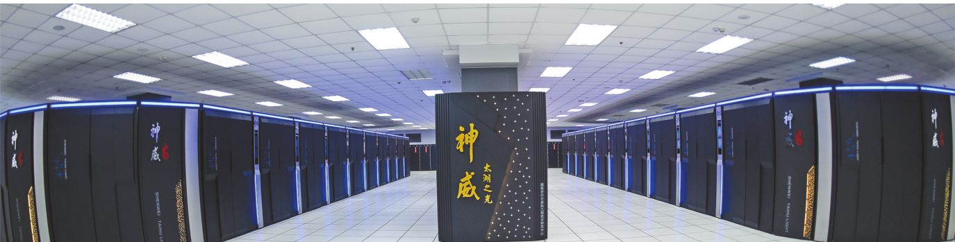
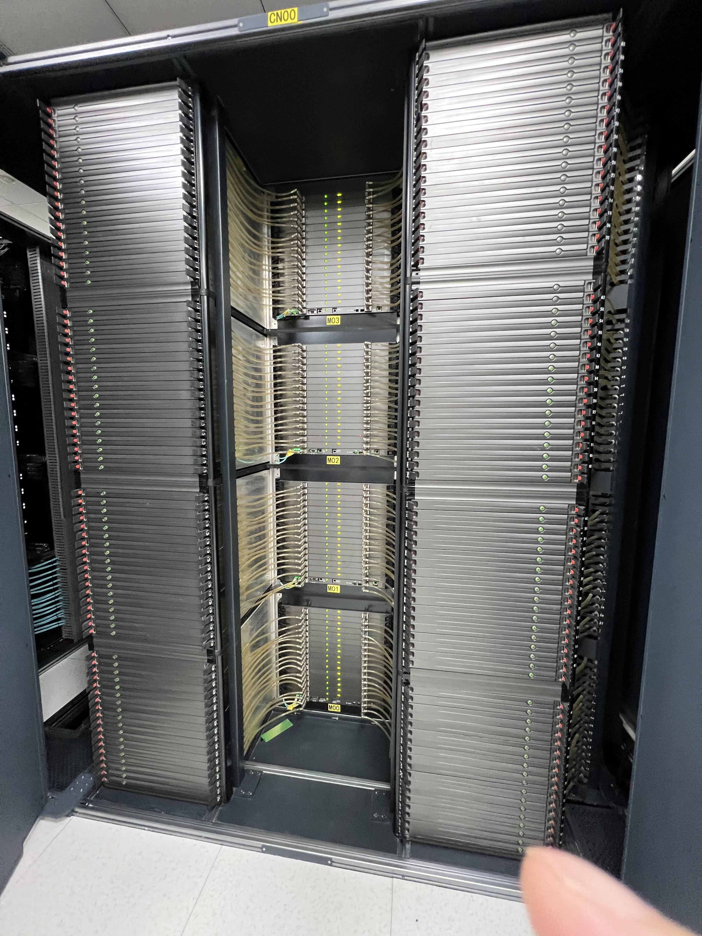
About Taihulight太湖之光
40960 Chinese-designed SW26010 manycore 64-bit RISC processors
X (256 processing cores + 4 auxiliary cores ) per SW26010
= 10,649,600 CPU cores
The processing cores feature 64 KB of scratchpad memory for data (and 16 KB for instructions) and communicate via a network on a chip,
OS: Sunway RaiseOS 2.0.5 on linux with its its own customized implementation of OpenACC2.0

Slide 43
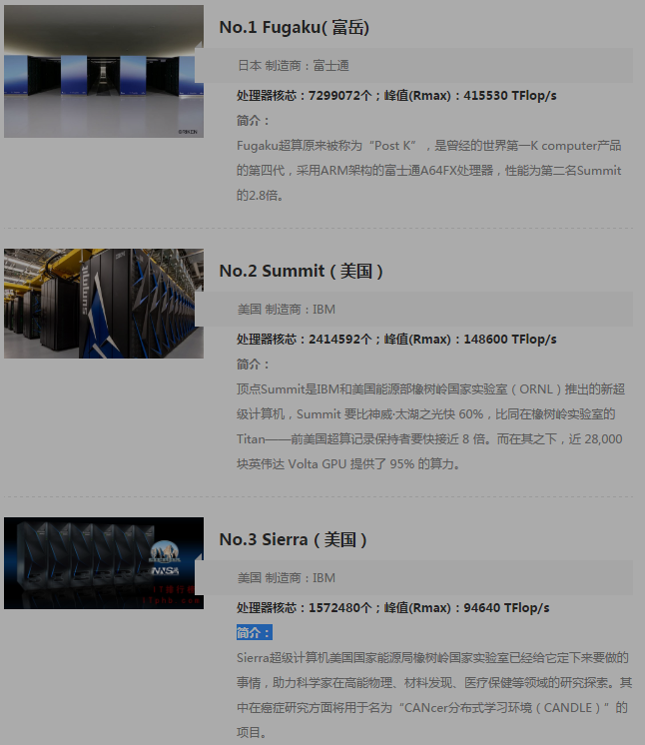
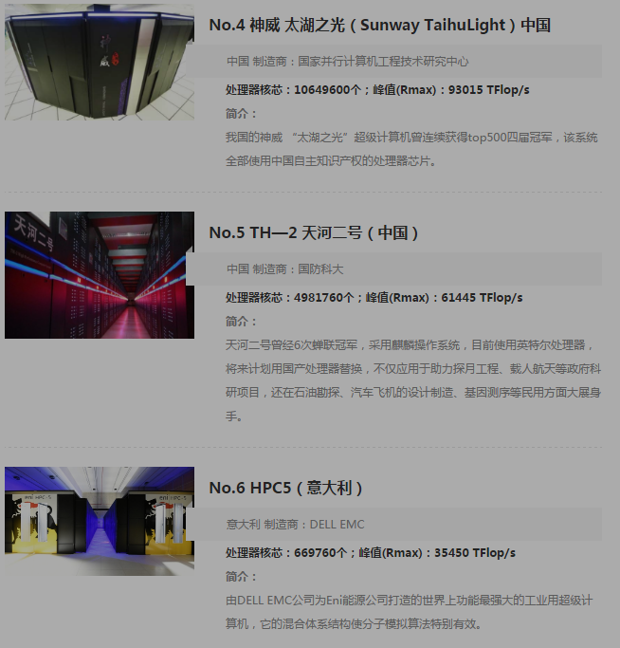
Newest Top 10 June 2020

Slide 44
Chip technology
高纯硅要求99.999999999%,几乎全赖进口，传统霸主依然是德国Wacker和美国Hemlock(美日合资)
硅材料
晶圆
设计与制造
核心设备
封测
台湾的天下，排名世界第一的日月光，还跟着一堆实力不俗的小弟：矽品、力成、南茂、欣邦、京元电子。
大陆的三大封测巨头：长电科技、华天科技、
通富微电
一块300mm直径的晶圆，16nm工艺可以做出100块芯片，10nm工艺可以做出210块芯片，价格可便宜了一半
刻蚀机，中国的状况要好很多，16nm已经量产，7-10nm也在上
离子注入机70%的市场份额是美国应用材料公司
美英特尔、韩三星、日东芝、意法半导体；台湾的：旺宏电子；中国华润微电子等。 但中国高端芯片几乎空白
晶圆代工厂：
台积电，中芯国际
光刻机，荷兰阿斯麦公司(ASML)唯一高端光刻机生产商（12，24，40台/年）
高通、博通、AMD，
中国台湾的联发科，
大陆的华为海思

Slide 45
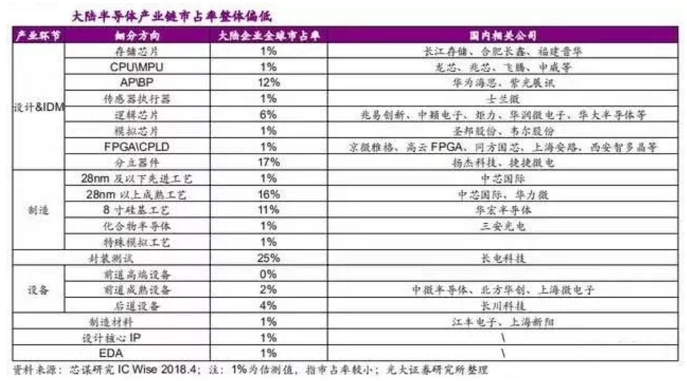
Chip technology
中国芯片的总体水平差不多处在刚刚实现零突破的阶段，虽然市场份额微乎其微，但每个领域都参了一脚，前景还是可期待的。

Slide 46
What are the Big Bananas ?
Eckert-Mauchly Award
http://www.computer.org/portal/web/awards/eckert
Administered jointly by ACM and IEEE Computer Society. The award of $5000 is given for contributions to computer and digital systems architecture where the field of computer architecture is considered at present to encompass the combined hardware-software design and analysis of computing and digital systems.

Slide 47
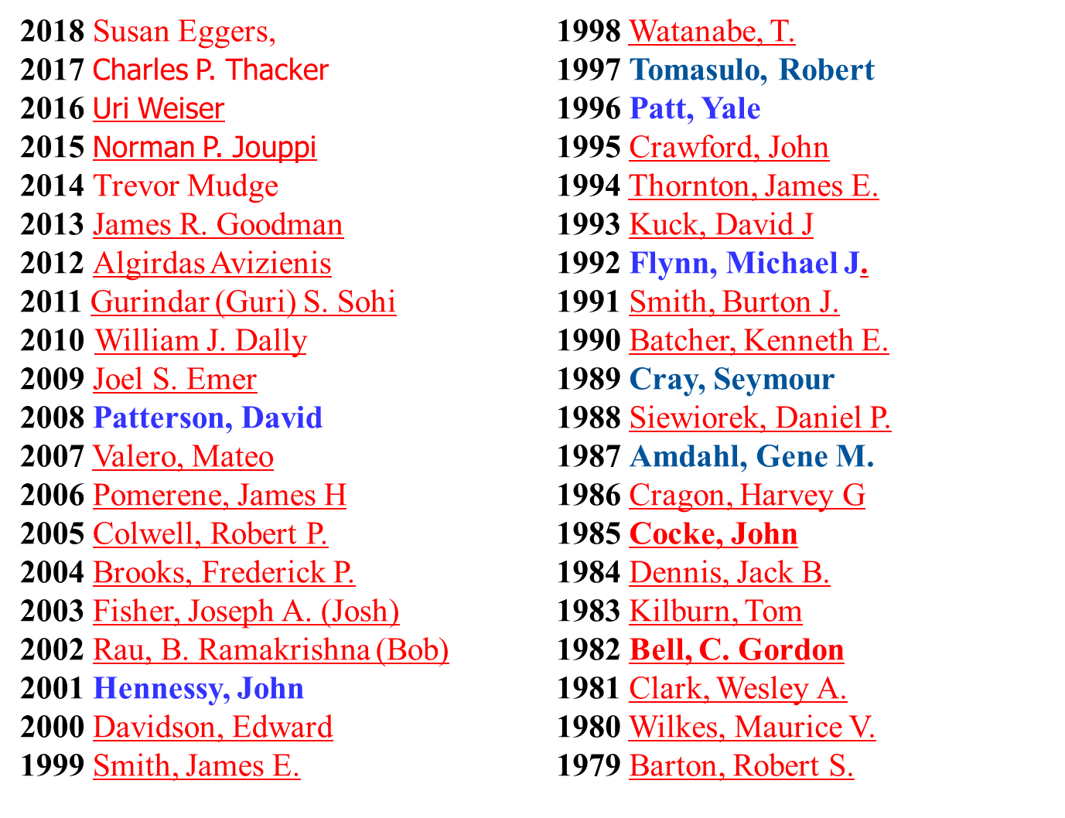
Eckert-Mauchly Award Recipients

Slide 48
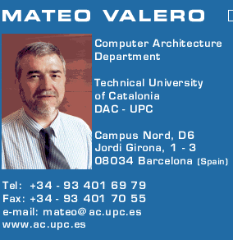
Big Men in Architecture(1)
2007Mateo Valero
http://personals.ac.upc.edu/mateo/
For important contributions to instruction level parallelism and superscalar processor design.

Slide 49
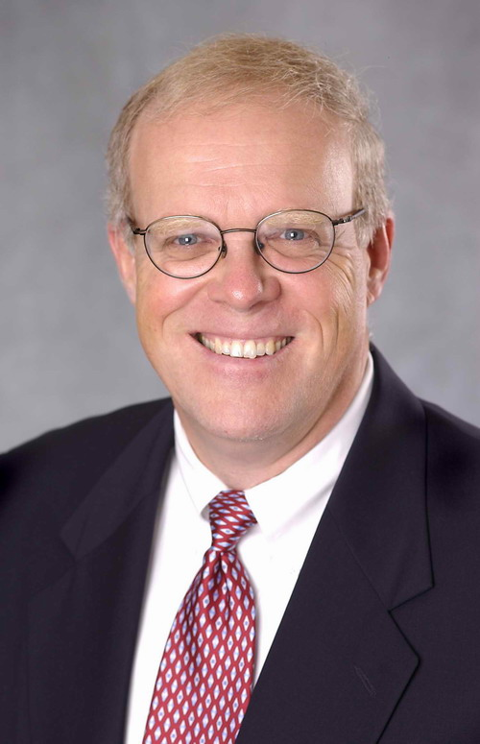
Big Men in Architecture(2)
2001 Hennessy, John
For being the founder and chief architect of the MIPS Computer Systems and contributing to the development of the landmark MIPS R2000 microprocessor.

Slide 50
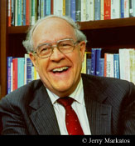
Big Men in Architecture(3)
2004 Eckert-Mauchly Award
"For the definition of computer architecture and contributions to the concept of computer families and to the principles of instruction set design; for seminal contributions in instruction sequencing, including interrupt systems and execute instructions; and for contributions to the IBM 360 instruction set architecture."
Frederick P. Brooks
http://www.cs.unc.edu/~brooks/
1999 ACM Turing Award
landmark contributions to computer architecture, operating systems, and software engineering."

Slide 51
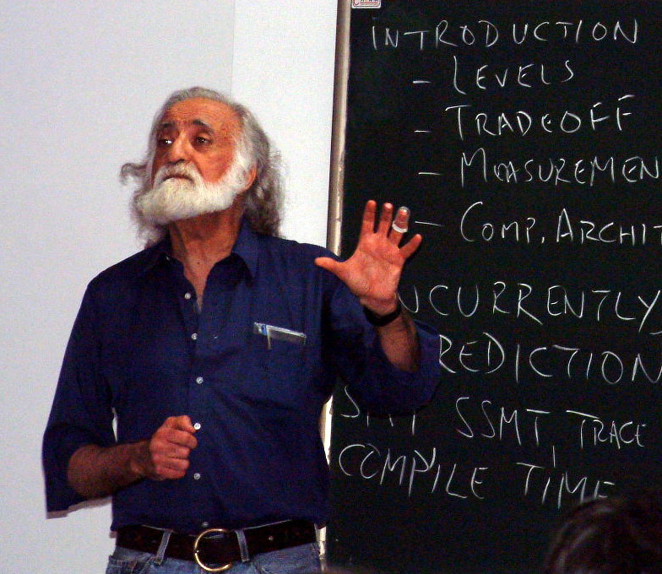
Big Men in Architecture(5)
1996 Yale Patt
For important contributions to instruction level parallelism and superscalar processor design.
Introduction to computing systems
（2013-2017, 2019）

Slide 52
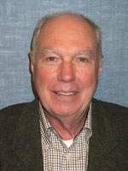
Big Men in Architecture(6)
1992 Michael J. Flynn
http://www.cpe.calpoly.edu/IAB/flynn.html
For his important and seminal contributions to processor organization and classification, computer arithmetic and performance evaluation.

Slide 53
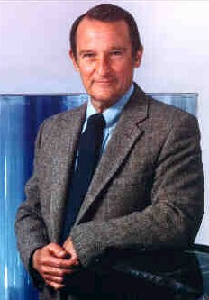
Big Men in Architecture(7)
1989 Cray, Seymour
For a career of achievements that have advanced supercomputing design.

Slide 54
Big Men in Architecture(8)
1987 Amdahl, Gene M. For outstanding innovations in computer architecture, including pipelining, instruction look-ahead, and cache memory.
In 1975, Dr. Amdahl stands beside the Wisconsin Integrally Synchronized Computer (WISC), which he designed in 1950. It was built in 1952. (Image courtesy of Dr. Gene M. Amdahl.)

Slide 55
Top conferences and Journals
Top conference:
ISCA
MICRO,
…
Top journals:
IEEE Tran. on Computers IF 3.131
ACM Tran. on Computer Systems IF 1.917
IEEE Tran. on Parallel and Distributed Systems. IF 3.402

Slide 56
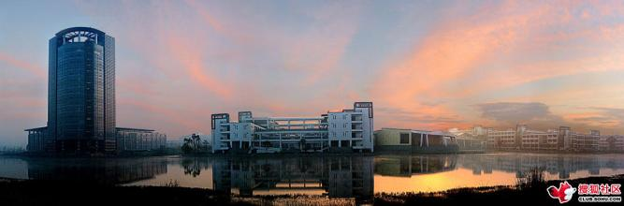
What’s a CA designer’s task ?

Slide 57
Computer Design Engineering life cycle
Evaluating Existing
Systems for
Bottleneck(app.B)
Benchmarks(1.8)
User requirement
Analysis(1.2)
Quantitative Principles
1.9
Technology Trend 1.4
Power Trend 1,5
Cost Trend 1.6
Application Trend 1,7
Implement Next
Generation System
Simulate New
Designs and
Organizations
Workloads
Evaluating for price peformance(1.8)
Notes:
Requirement Analysis:
Market analysis: who you will sell 4-1.2
desktop, server, embedded system, HPC
Different markets has different driven motivations.
When design a desktop, it aims to obtain best price-performance.
For the servers, dependability is critical, then the scalability, and throughput.
For the embedded computer systems, price is a key factor, while real-time performance is important . And power efficiency and memory size is always under consideration.
2. Functional requirement: 4-1.3
3. Performance requirement:
4. Power
5. Unfuntional requirements: availability, dependibility 1.7
7. Cost/price

Slide 58
Topics in Chapter 1
1.1 Introduction
1.2 Classes of computers
1.3 Defining computer architecture and What’s the task of computer design?
1.4 Trends in Technology
1.5 Trends in power in Integrated circuits
1.6 Trends in Cost
1.7 Dependability
1.8 Measuring, Reporting and summerizing Perf.
1.9 Quantitative Principles of computer Design
1.10 Putting it altogether

Slide 59
Summary: Task of computer design
Considerations:
functional and non functional requirements
implementation complexity
Complex designs take longer to complete
Complex designs must provide higher performance to be competitive
Technology trends
Not only what's available today, but also what will be available when the system is ready to ship. (more on this later)
Trends in Power in IC
Trends in cost
Arguments
Evaluate Existing Systems for Bottlenecks
Quantitative Principles

Slide 60
Reading Assignments
Chapter 1， Chapter 2.
Homework1 for chapter 1 will be loaded on website

Slide 61
End !
Thank you !

